Slide 1
The Controversy with Dictionary Keywords on Social Media
A Forensics Study
Presented by Tarannum Zaki
CS 895: Web Archiving Forensics
Old Dominion University
Fall 2022
December 05, 2022
Tarannum Zaki CS 895: Web Archiving Forensics @tarannum_zaki @WebSciDL

Slide 2
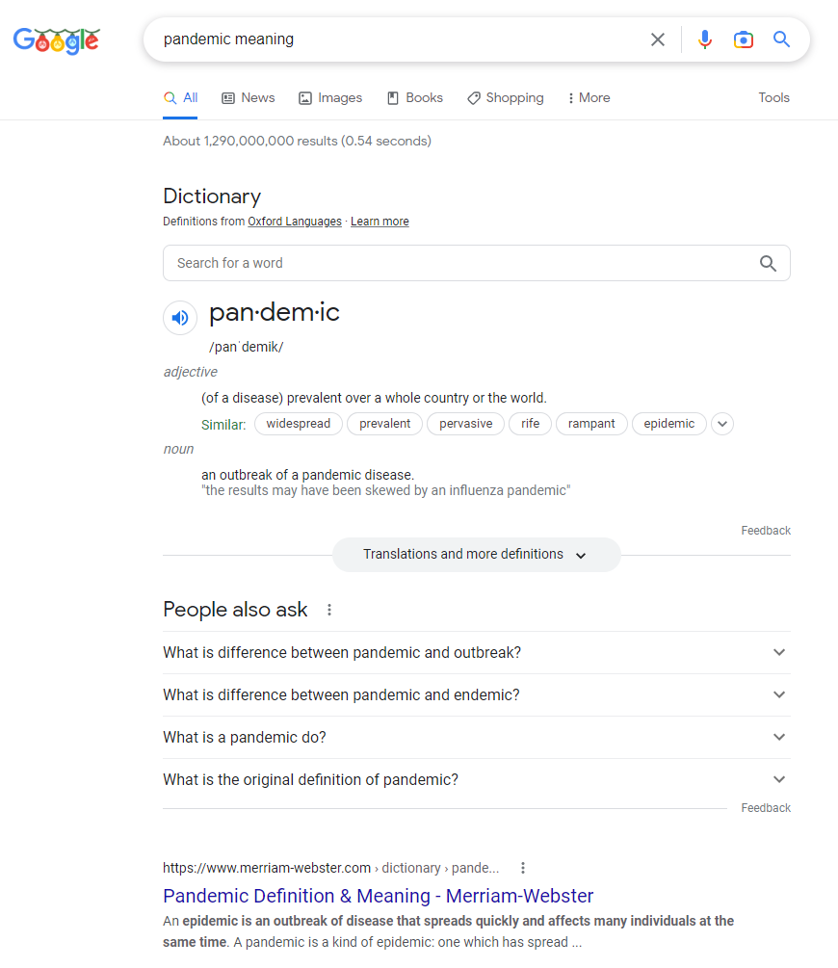
What are Dictionary Keywords?
Words or Phrases
People usually type into search engines to find the meaning of a word or phrase
https://www.google.com/search?q=pandemic+meaning
Tarannum Zaki CS 895: Web Archiving Forensics @tarannum_zaki @WebSciDL

Slide 3
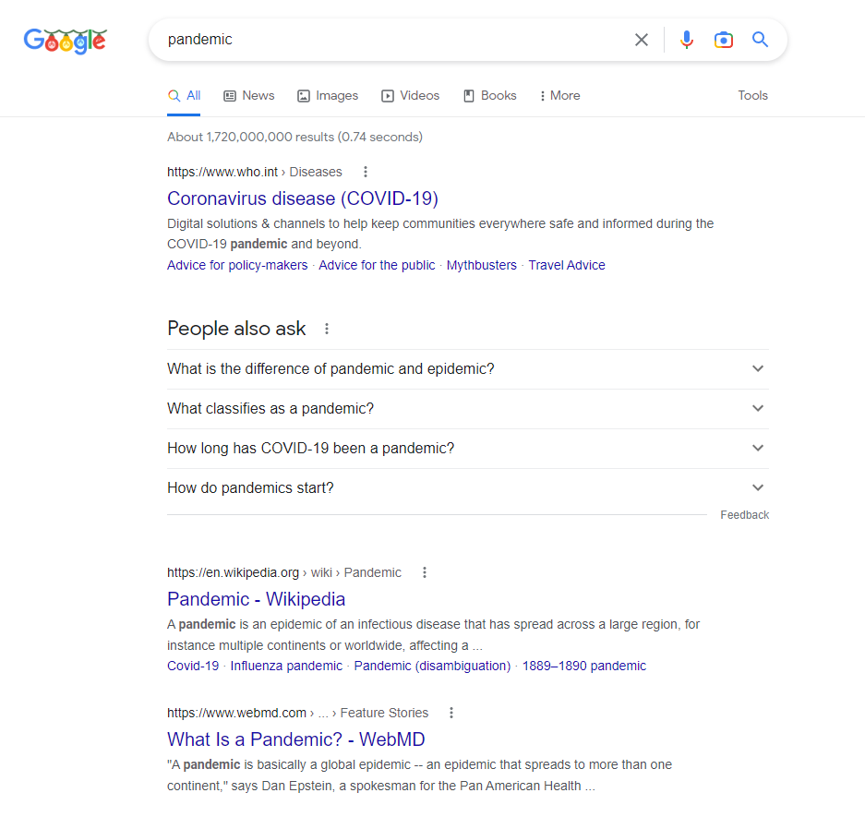
Common Sources of Dictionary Keywords
Pandemic
Google English dictionary (provided by Oxford languages)
Wikipedia
Relevant organization’s website (e.g. https://www.webmd.com/)
Merriam-Webster dictionary
https://www.google.com/search?q=pandemic+meaning
https://www.google.com/search?q=pandemic
Tarannum Zaki CS 895: Web Archiving Forensics @tarannum_zaki @WebSciDL

Slide 4
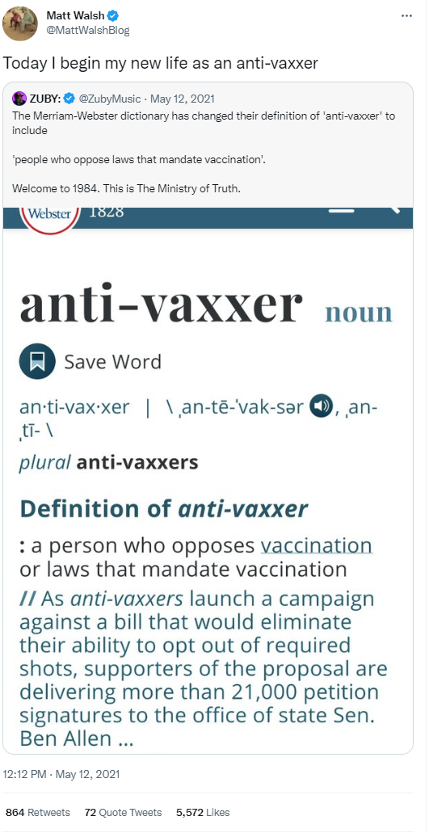
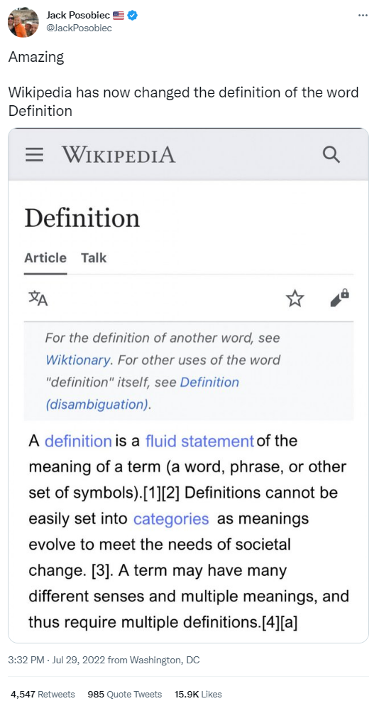
What’s the Controversy about?
https://twitter.com/MattWalshBlog/status/1392513019368943618
https://twitter.com/JackPosobiec/status/1553101227889680384
Tarannum Zaki CS 895: Web Archiving Forensics @tarannum_zaki @WebSciDL

Slide 5
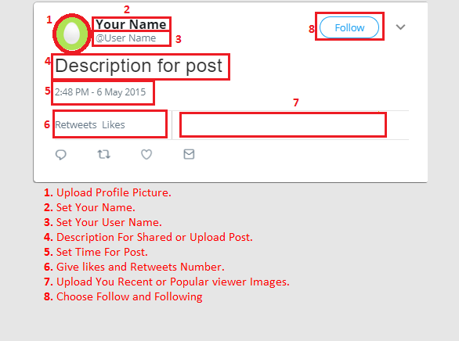
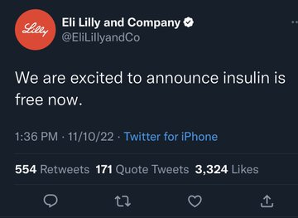
Creating a Fake Twitter Post
https://zeoob.com/wp-content/uploads/2018/07/Tweeter-tweet.png
https://pbs.twimg.com/media/FhQpfC_XwAAXcqp?format=jpg&name=360x360
Complex Metadata Arrangement
Tarannum Zaki CS 895: Web Archiving Forensics @tarannum_zaki @WebSciDL

Slide 6
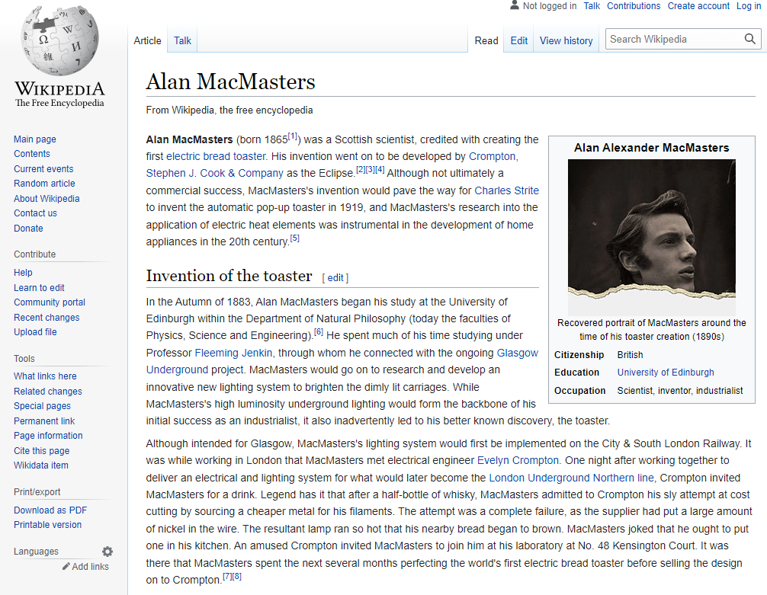
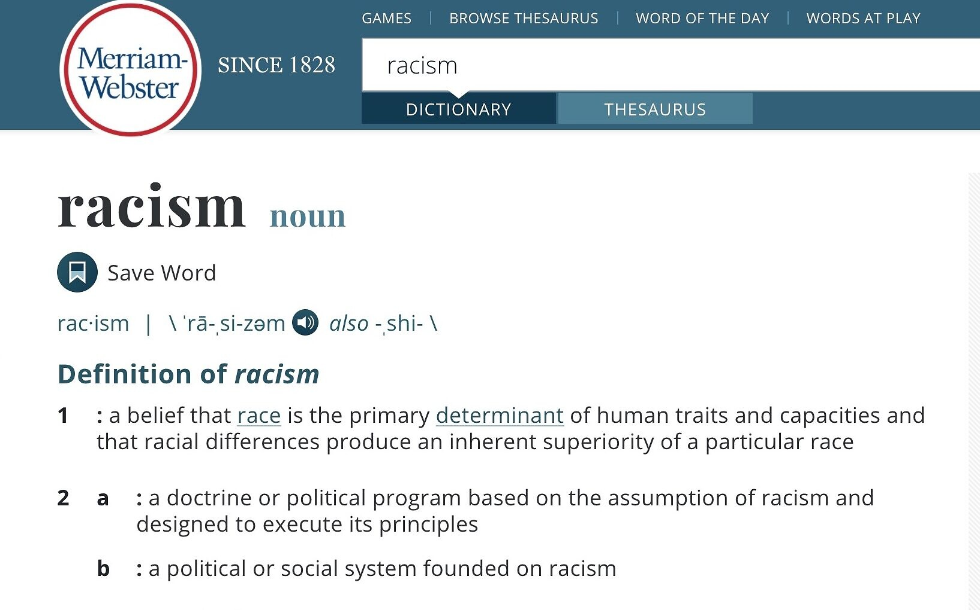
How easy is it to create a Fake Wiki/Dictionary Web Page?
Title
Menu and search bars
Logo
Title
Menu and search bars
Logo
Description
Phonetic status, pronunciation
Table of content
Description
https://www.telesurenglish.net/__export/1591827181791/sites/telesur/img/2020/06/10/merriam-webster-2-e1591772597232.jpg_1718483346.jpg
https://archive.ph/IL2ay
Photo and basic info
Less Complex Metadata Arrangement
Tarannum Zaki CS 895: Web Archiving Forensics @tarannum_zaki @WebSciDL

Slide 7
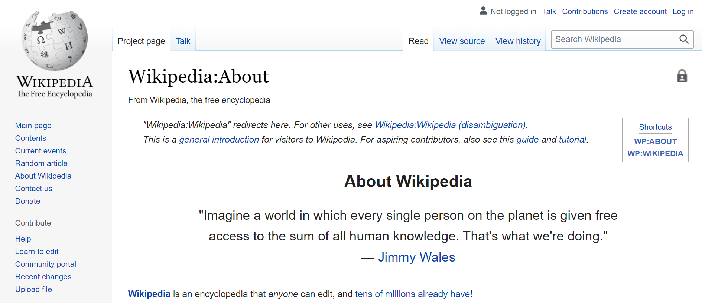
How often Wikipedia Pages are verified?
This ‘Alan MacMasters’ Wikipedia article stayed online for more than nine years!
https://en.wikipedia.org/wiki/Wikipedia:About
https://archive.ph/IL2ay
https://www.bbc.com/news/the-reporters-63622746
Tarannum Zaki CS 895: Web Archiving Forensics @tarannum_zaki @WebSciDL

Slide 8
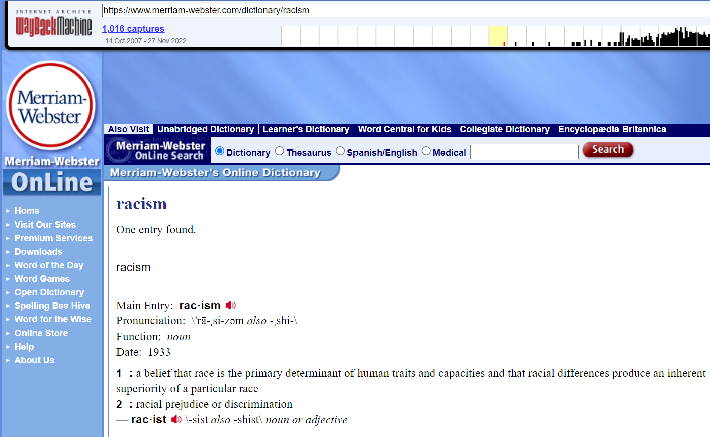
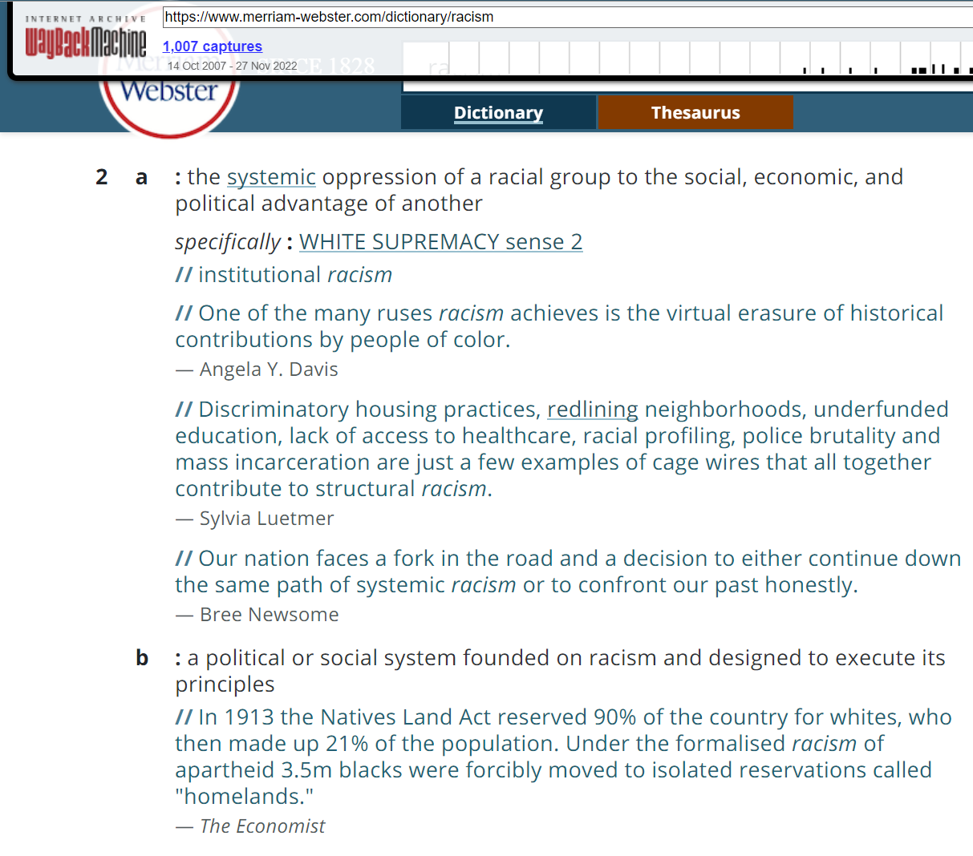
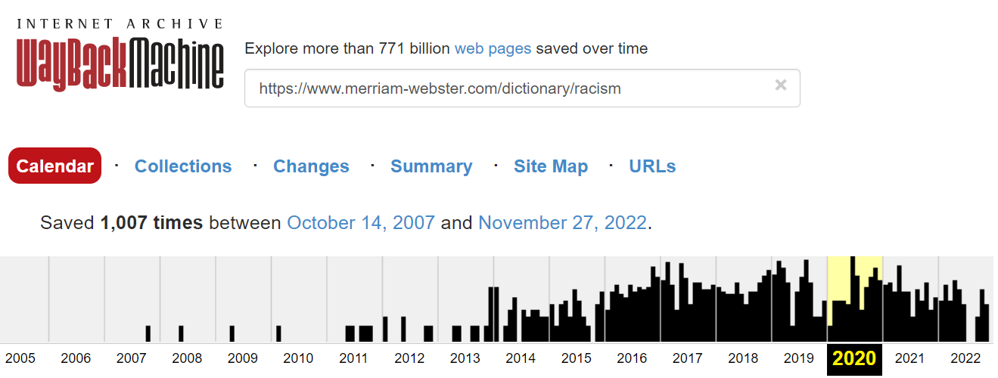
How often Dictionary Words are updated?
Webster's Dictionary is updated annually and has been completely re-edited and revised every 10 to 12 years.
Definition changed
2007
2020
https://web.archive.org/web/20200101000000*/https://www.merriam-webster.com/dictionary/racism
https://web.archive.org/web/20071014174747/https://www.merriam-webster.com/dictionary/racism
https://web.archive.org/web/20201229105952/https://www.merriam-webster.com/dictionary/racism
https://www.merriam-webster.com/about-us/ongoing-commitment
Tarannum Zaki CS 895: Web Archiving Forensics @tarannum_zaki @WebSciDL

Slide 9
Websites that serve as information resources are a good target for spreading misinformation
Tarannum Zaki CS 895: Web Archiving Forensics @tarannum_zaki @WebSciDL

Slide 10
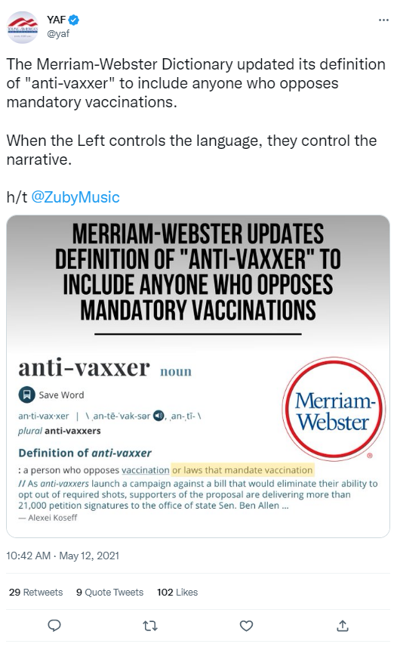
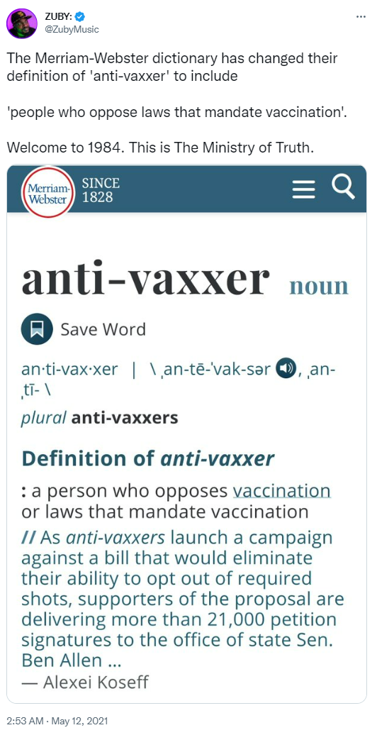
Did the Merriam-Webster Dictionary really change the definition of ‘anti-vaxxer’?
https://twitter.com/MattWalshBlog/status/1392513019368943618
https://twitter.com/yaf/status/1392490435935973378
https://twitter.com/ZubyMusic/status/1392372369822556160
Tarannum Zaki CS 895: Web Archiving Forensics @tarannum_zaki @WebSciDL

Slide 11
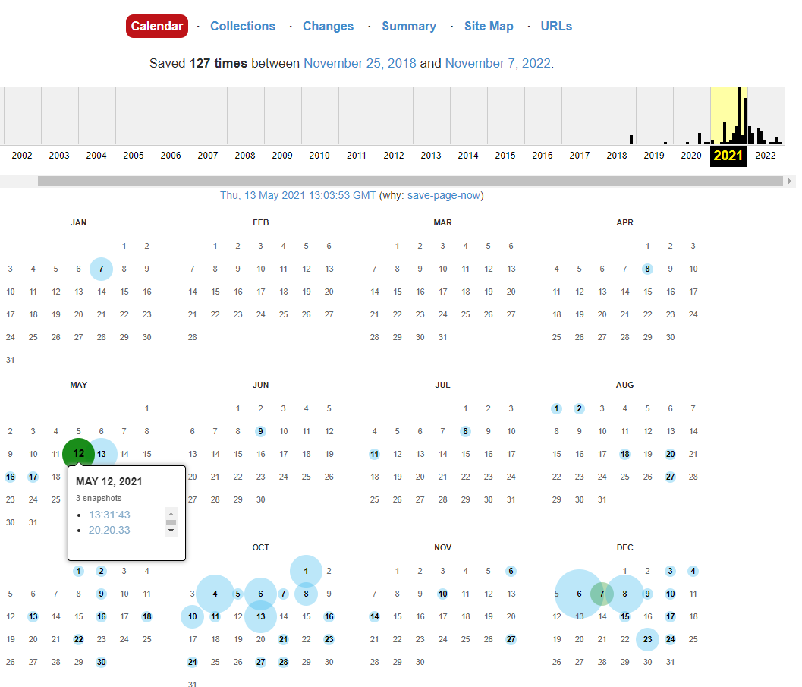
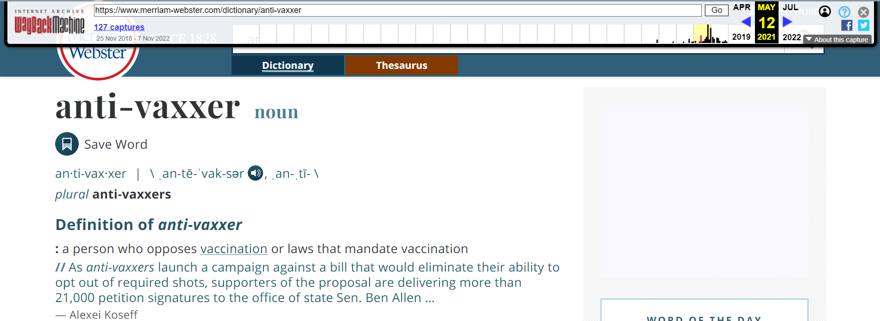
The definition of ‘anti-vaxxer’ on May 12, 2021
The definition matches with that of the shared screenshot
https://web.archive.org/web/20210512133143/https://www.merriam-webster.com/dictionary/anti-vaxxer
https://web.archive.org/web/20210101000000*/https://www.merriam-webster.com/dictionary/anti-vaxxer
Tarannum Zaki CS 895: Web Archiving Forensics @tarannum_zaki @WebSciDL

Slide 12
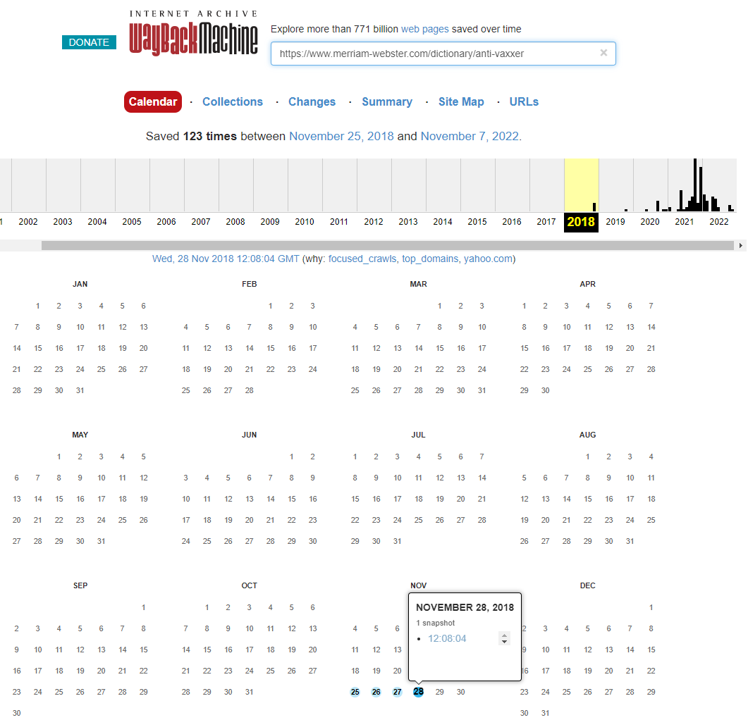
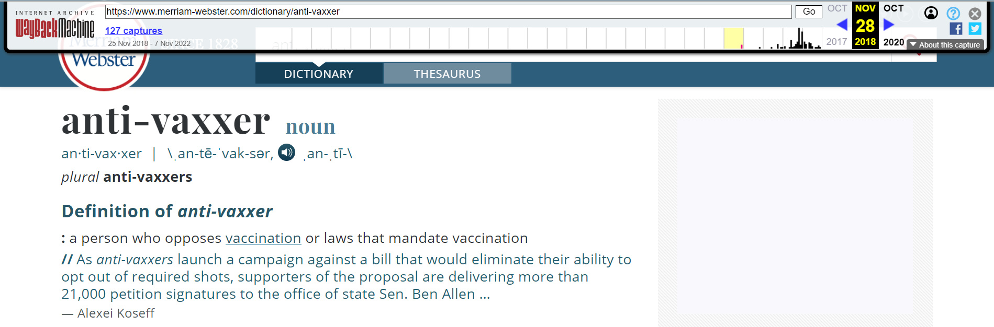
The definition of ‘anti-vaxxer’ is the same since 2018
The oldest archived version is in the year of 2018
https://web.archive.org/web/20181128120804/https://www.merriam-webster.com/dictionary/anti-vaxxer
https://web.archive.org/web/20180101000000*/https://www.merriam-webster.com/dictionary/anti-vaxxer
Tarannum Zaki CS 895: Web Archiving Forensics @tarannum_zaki @WebSciDL

Slide 13
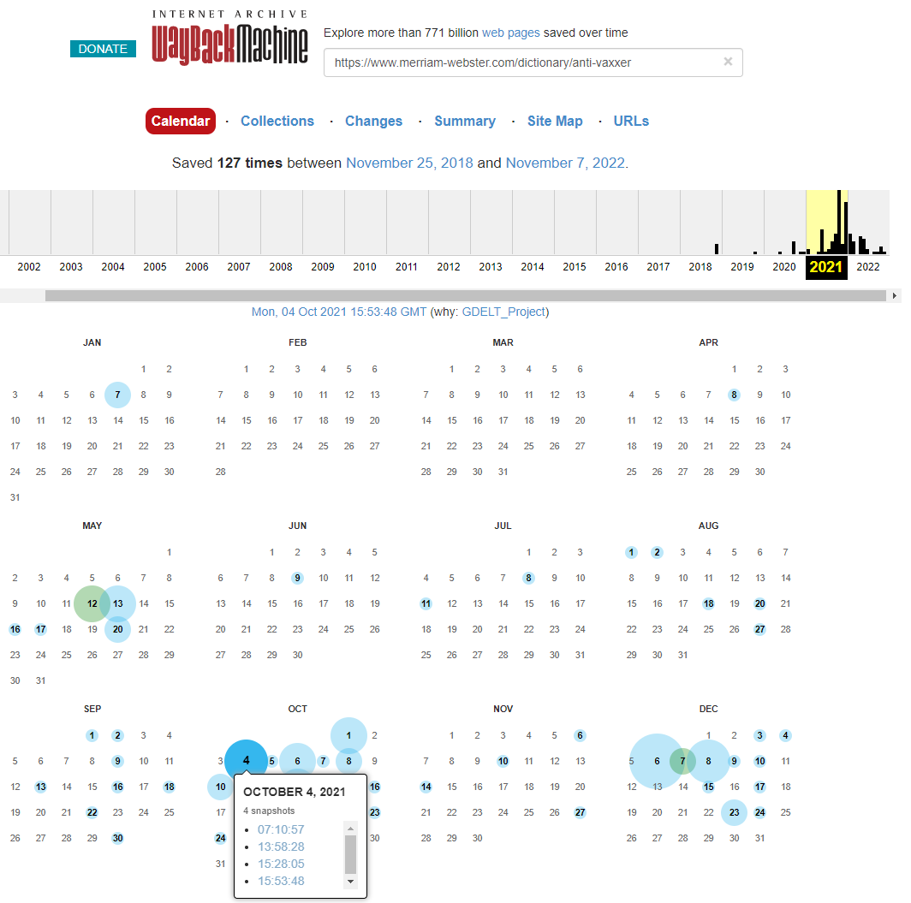
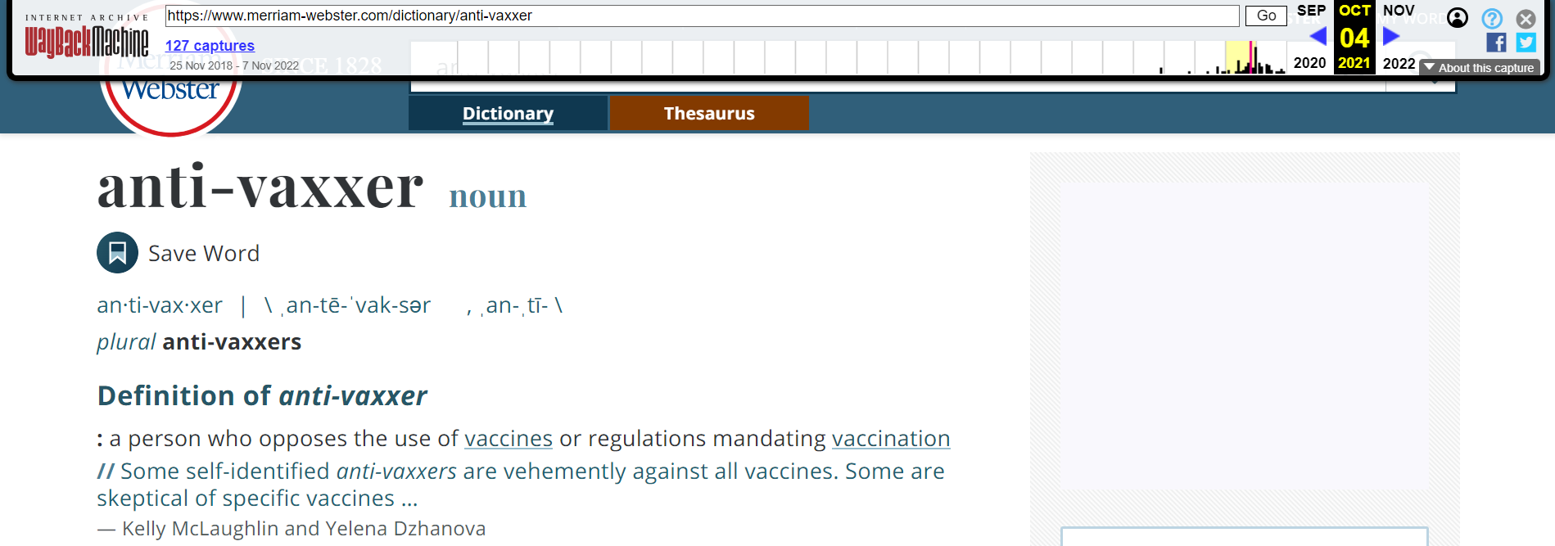
The definition of ‘anti-vaxxer’ did change on October 04, 2021
The claim of change on the posts were dated as May 12, 2021
The earliest change after 2018 was October 04, 2021
https://web.archive.org/web/20211004155348/https://www.merriam-webster.com/dictionary/anti-vaxxer
https://web.archive.org/web/20210101000000*/https://www.merriam-webster.com/dictionary/anti-vaxxer
Tarannum Zaki CS 895: Web Archiving Forensics @tarannum_zaki @WebSciDL

Slide 14
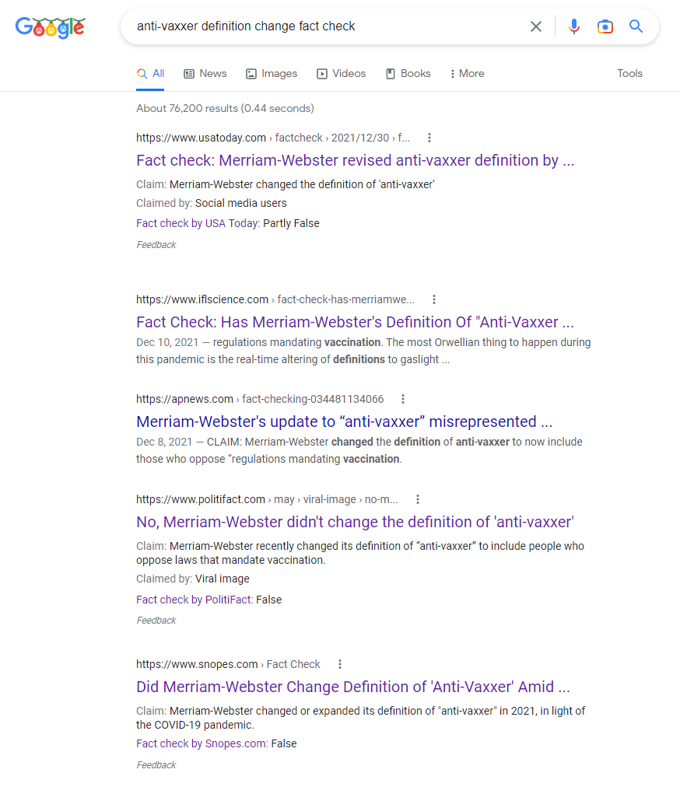
Online Search Results for the change of definition of ‘anti-vaxxer’
Google search shows the claim has been verified by fact-checking websites
Partly false or false
https://www.google.com/search?q=anti-vaxxer+definition+change+fact+check
Tarannum Zaki CS 895: Web Archiving Forensics @tarannum_zaki @WebSciDL

Slide 15
So, a fake claim was circulating on the social media regarding the definition of the word ‘anti-vaxxer’ then
Tarannum Zaki CS 895: Web Archiving Forensics @tarannum_zaki @WebSciDL

Slide 16
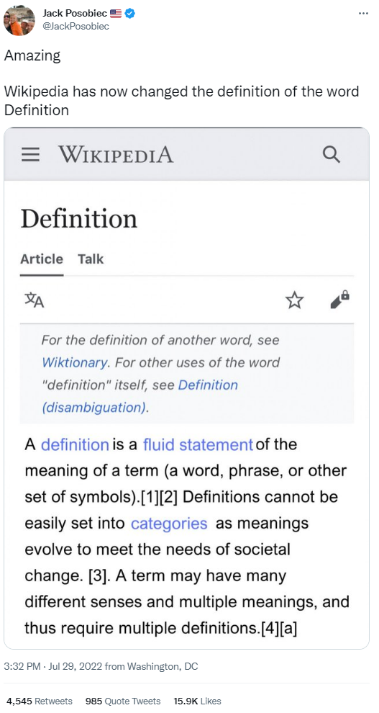
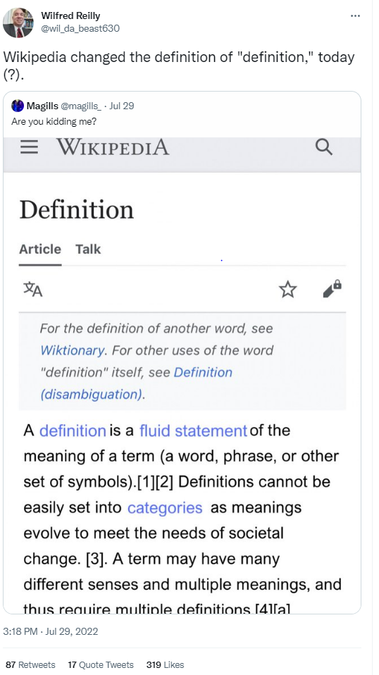
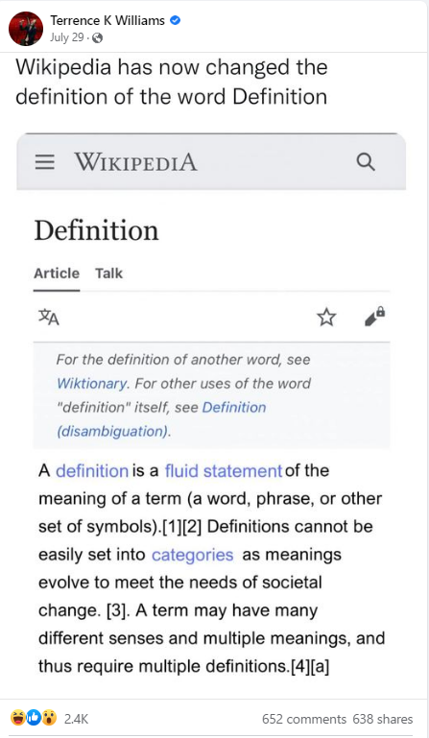
Did the Wikipedia really change the definition of ‘definition’?
https://twitter.com/JackPosobiec/status/1553101227889680384
https://twitter.com/wil_da_beast630/status/1553097604216635400
https://www.facebook.com/terrencekwilliams/posts/pfbid052fKirasApGLjCYD4djUF9bZzSeKahaNum7sE5pyPFKh9YprUaVM4q2W2sc81Pgdl
Tarannum Zaki CS 895: Web Archiving Forensics @tarannum_zaki @WebSciDL

Slide 17
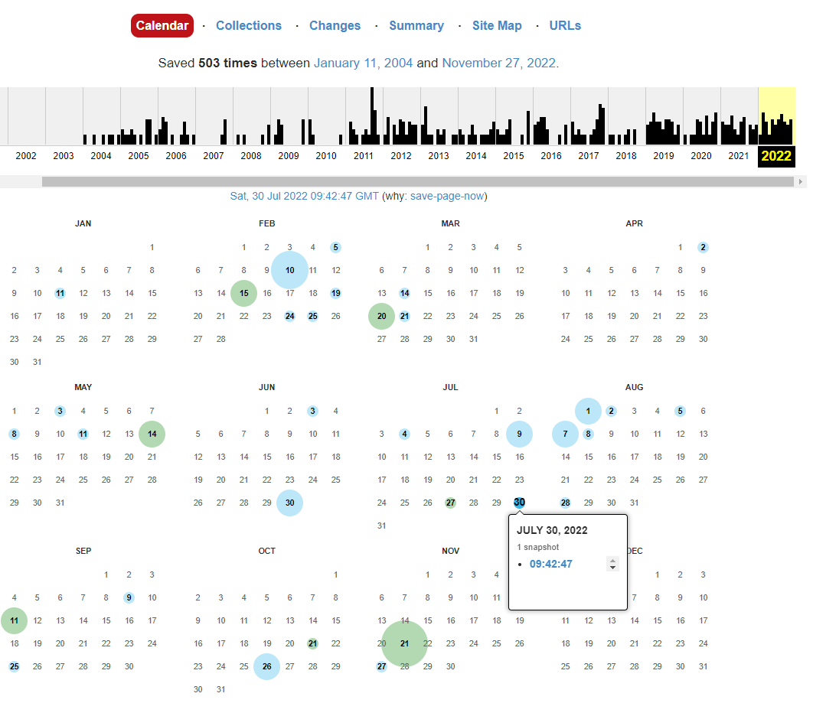
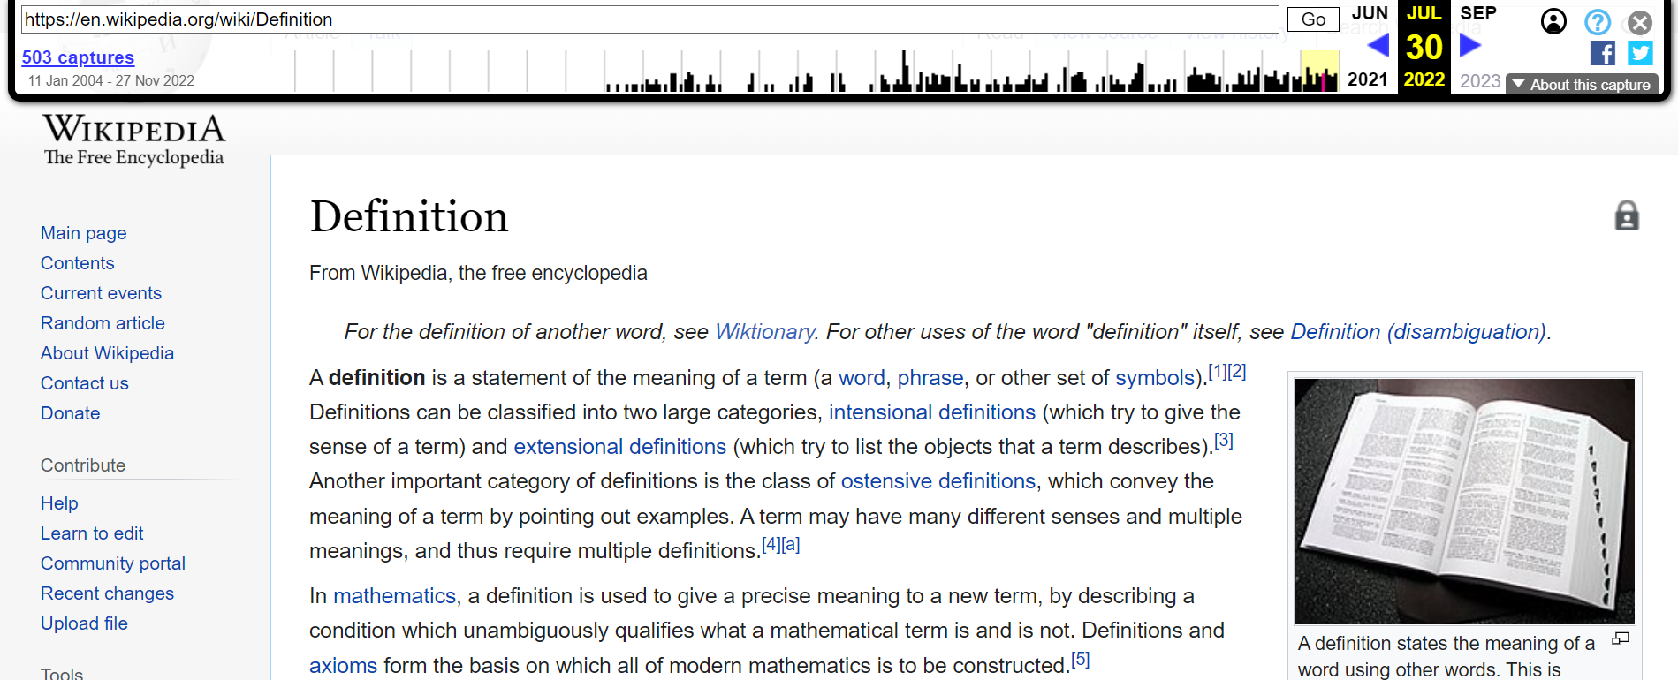
The definition of ‘definition’ adjacent to July 29, 2022
The definition does not match with that of the shared screenshot
https://web.archive.org/web/20220730094247/https://en.wikipedia.org/wiki/Definition
https://web.archive.org/web/20220101000000*/https://en.wikipedia.org/wiki/Definition
Tarannum Zaki CS 895: Web Archiving Forensics @tarannum_zaki @WebSciDL

Slide 18
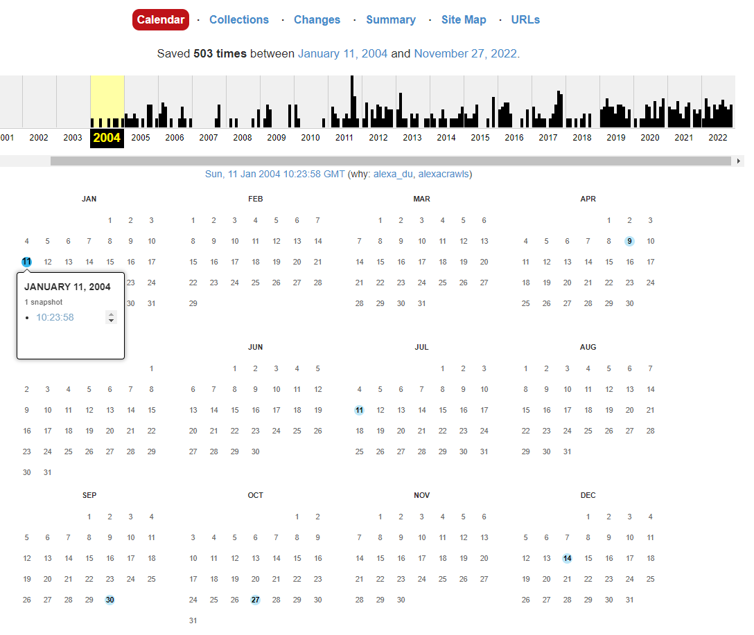
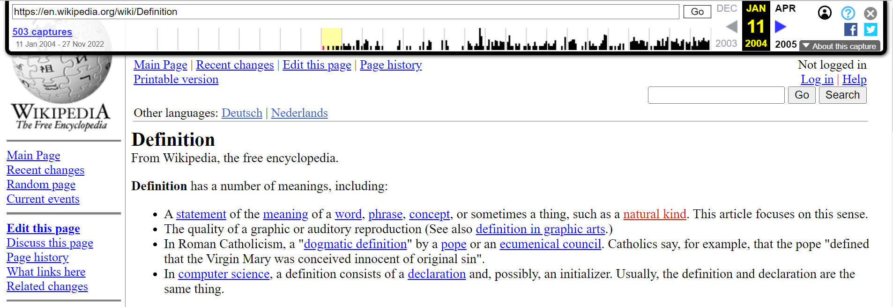
The oldest archived version of the definition of ‘definition’ is in 2004
The definition in the oldest archived version does not match with that of the shared screenshot
The definition in the oldest archived version partially matches with that of the archived version of July 2022
https://web.archive.org/web/20040111102358/https://en.wikipedia.org/wiki/Definition
https://web.archive.org/web/20040115000000*/https://en.wikipedia.org/wiki/Definition
Tarannum Zaki CS 895: Web Archiving Forensics @tarannum_zaki @WebSciDL

Slide 19
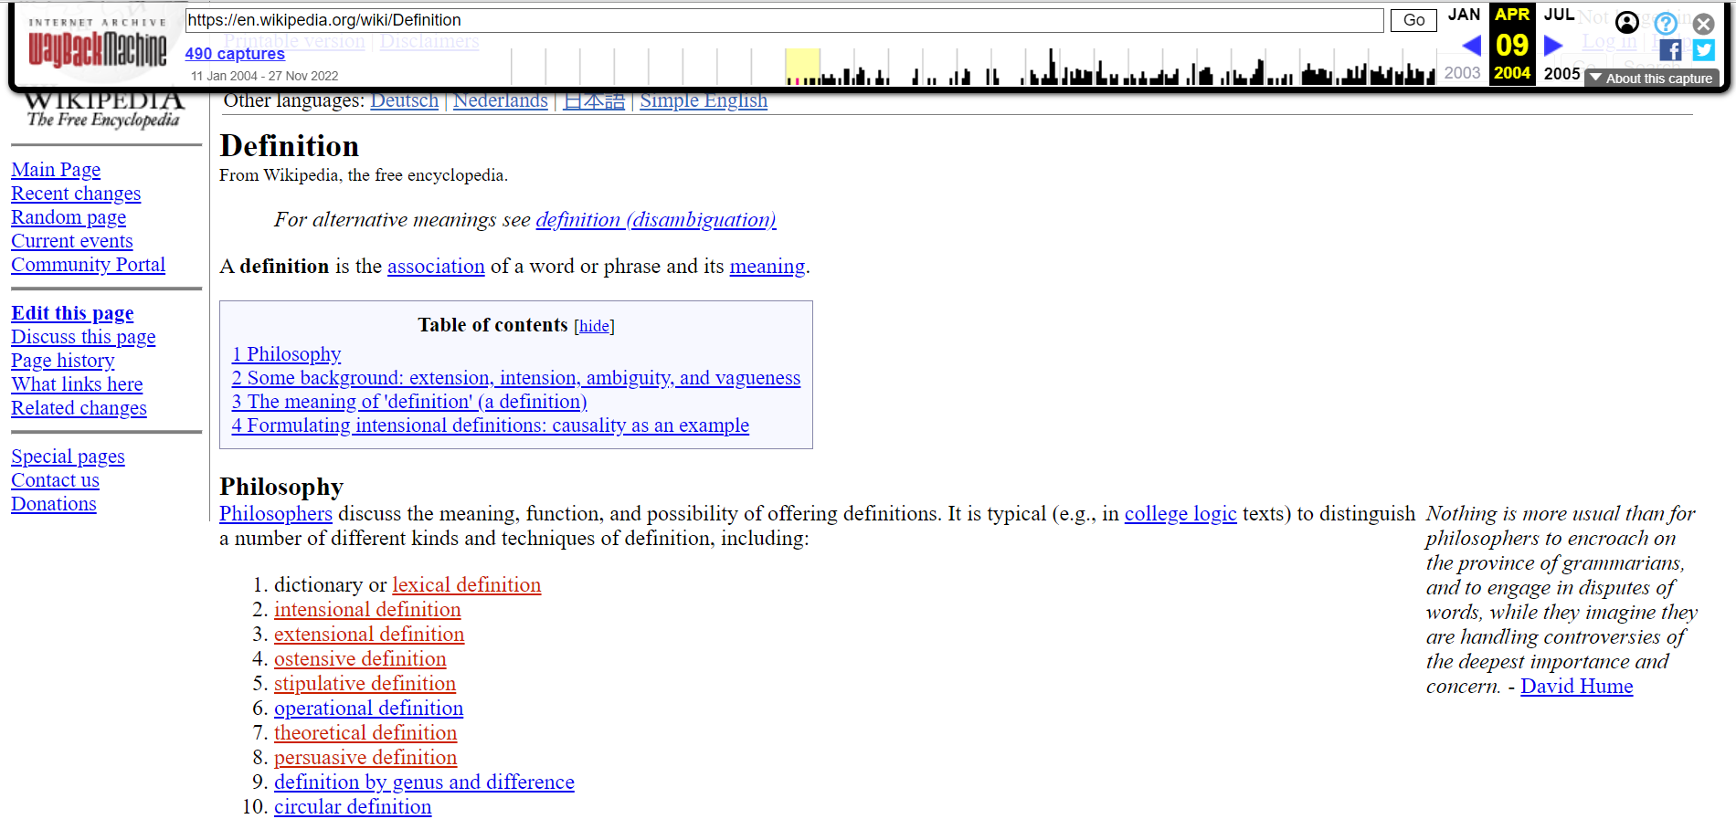
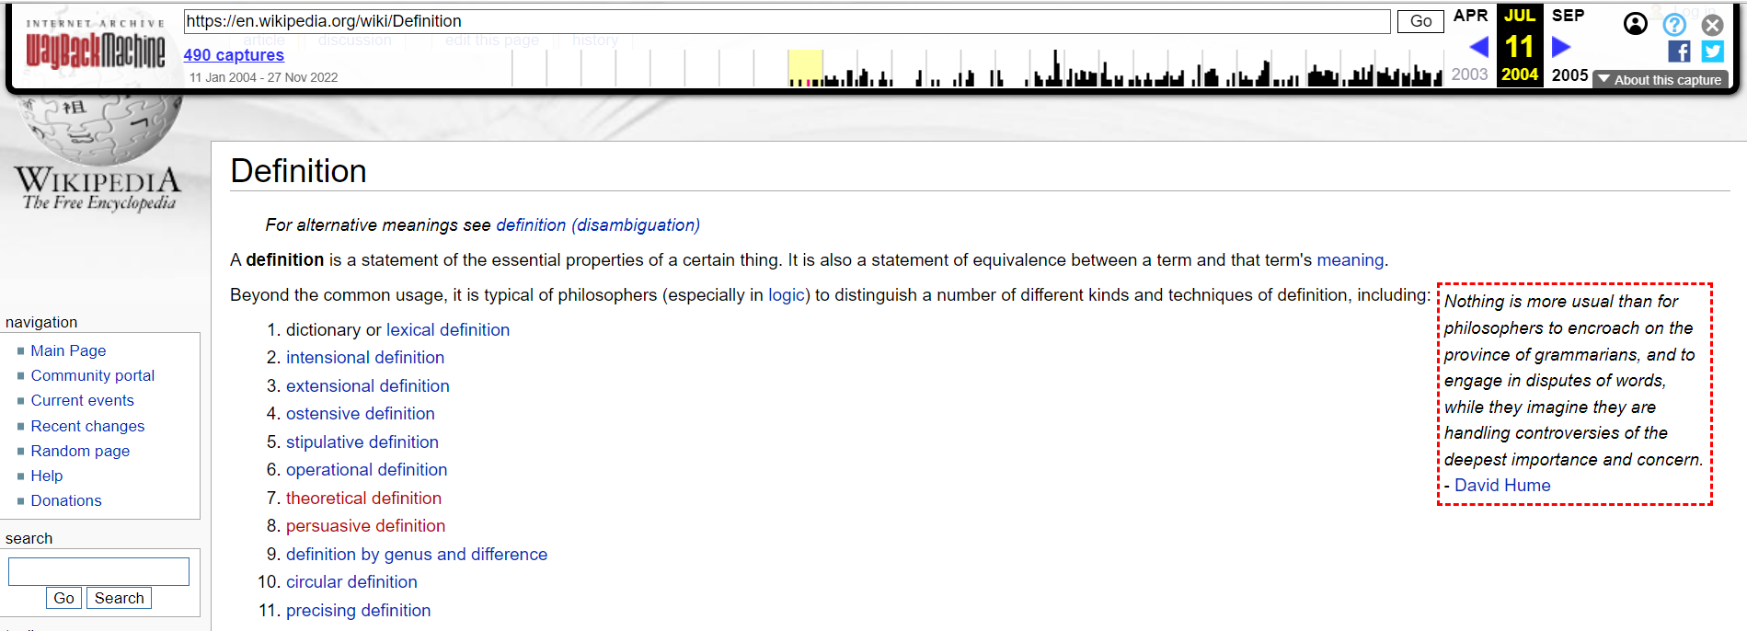
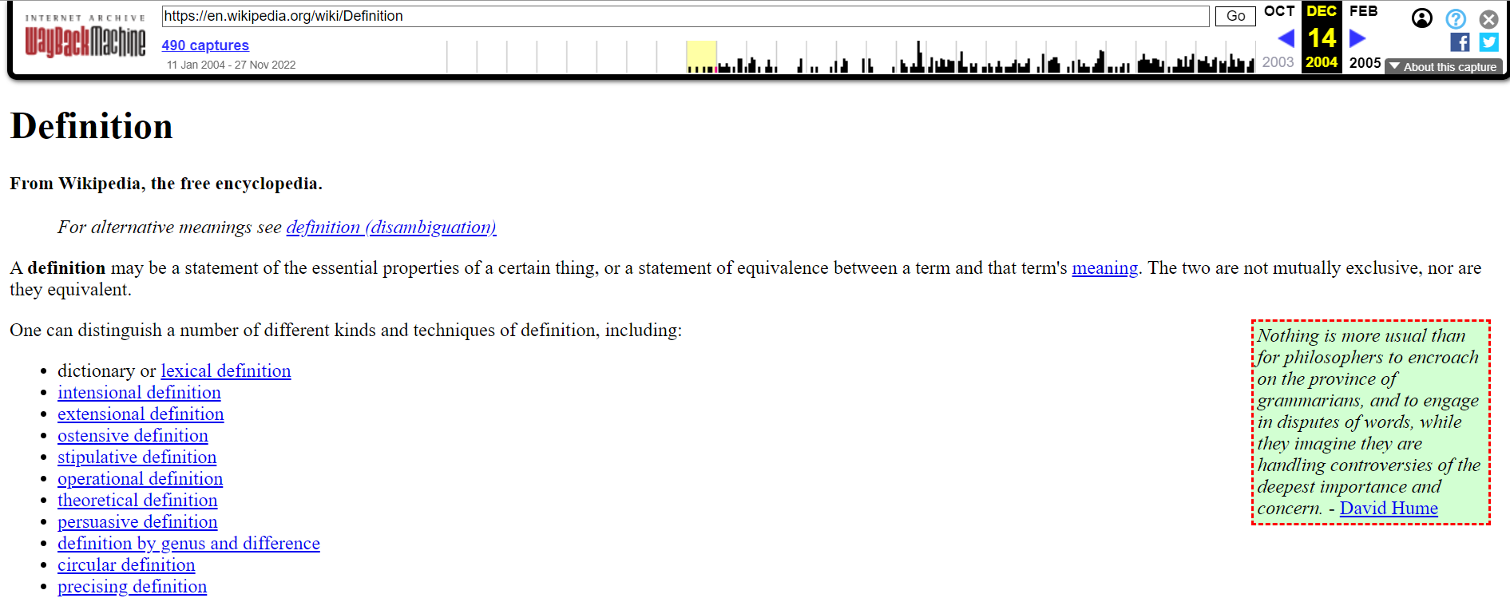
The definition of ‘definition’ changed frequently in 2004
https://web.archive.org/web/20040711101328/https://en.wikipedia.org/wiki/Definition
https://web.archive.org/web/20040409150130/https://en.wikipedia.org/wiki/Definition
A definition is the association of a word…
A definition is a statement of the…
A definition may be a statement of the…
https://web.archive.org/web/20040711101328/https://en.wikipedia.org/wiki/Definition
Tarannum Zaki CS 895: Web Archiving Forensics @tarannum_zaki @WebSciDL

Slide 20
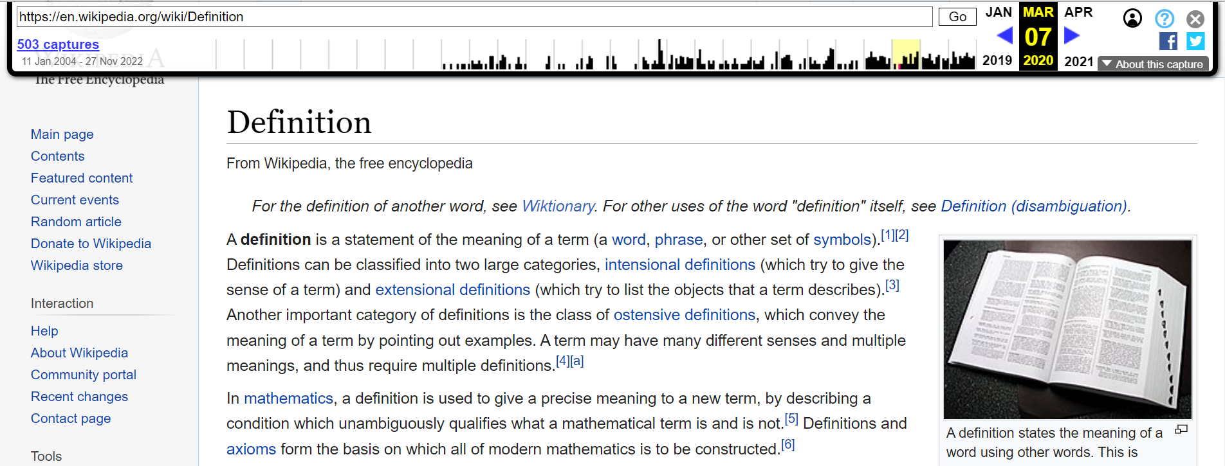
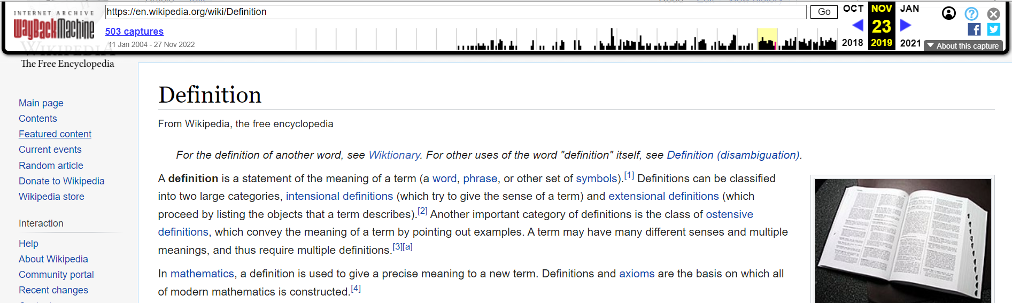
The definition of ‘definition’ is the same since March 07, 2020
https://web.archive.org/web/20191123075258/https://en.wikipedia.org/wiki/Definition
https://web.archive.org/web/20200307200708/https://en.wikipedia.org/wiki/Definition
(which proceed by listing the objects that a term describes)
(which try to list the objects that a term describes)
https://web.archive.org/web/20220730094247/https://en.wikipedia.org/wiki/Definition
Tarannum Zaki CS 895: Web Archiving Forensics @tarannum_zaki @WebSciDL

Slide 21
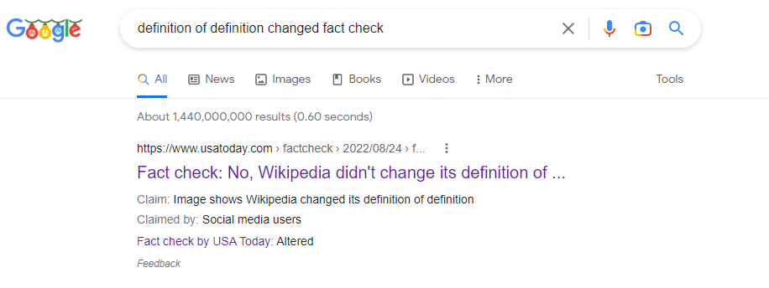
Online Search Results for the change of definition of ‘definition’
Altered
https://www.google.com/search?q=definition+of+definition+changed+fact+check
Google search shows the claim has been fact-checked
Tarannum Zaki CS 895: Web Archiving Forensics @tarannum_zaki @WebSciDL

Slide 22
The claim about the definition change of ‘definition’ was incorrect
Tarannum Zaki CS 895: Web Archiving Forensics @tarannum_zaki @WebSciDL

Slide 23
Key Takeaways
Both the claims regarding the definition change of particular keywords were false.
Fabricated screenshots are one of the widely used means for spreading misinformation.
There exists potential vulnerabilities in websites that serve as information resources.
Web archives can be used to rule out such controversies.
Tarannum Zaki CS 895: Web Archiving Forensics @tarannum_zaki @WebSciDL

